Slide 1
PRESENTED BY
Abdelrahman Gamal Eldeeb | 7416
Ahmed Reda Ali | 7417
May Tarek Allam | 7582
Alaa Mohamed Elkhouly | 7721
Kariman Tarek Mohamed |7733
Kholoud Waleed Ali | 7735

Slide 2
SUMOBOT

Slide 3
SUBTITELS
Literature review
Mechanical design
Electrical design
Control code
Conclusion
Cost

Slide 4
introduction
The purpose of this project is to make the participants able to participate in RoboGames by use of SumoBots that are highly effective and operational such that in the end they emerge to be winners.

Slide 5
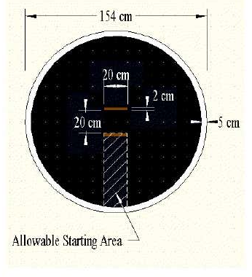
In this project, the team is required to participate and compete in a SumoBot competition held by RoboGames.
This competition has similar rules to the traditional Japanese sumo sport which mainly aims to push the opponent outside the ring which is 1.5 meter .
Two robots are competing. The ring is circular and has varying dimensions depending on the class, and each robot starts in a set line called shikari lines inside the ring.
Each match has three rounds, and the team wins a round when the opponent’s SumoBot touches the outside ring of the arena.
The teams follow the rules and regulation set by RoboGames which states that it is not allowed to damage or flip the opponent Bot.

Slide 6
Requirements | Target
Maintenance | Once per competition
Effective from all sides | All sides are equally powerful
Size | 20x20cm
Competitive | Fast enough to maneuver in attack and defense.
Autonomous Controlled | Fully controlled and easy to operate.
Safety | Does not damage other SumoBots.
Weight | <3kg

Slide 7
.
Existing Design #1: Sand Flea
The Newest Generation SumoBot “Sand Flea” was created by Boston dynamics and is appropriate benchmarking design in relation to the project.
This is because it has some specifications that can be applied in the current device that is being designed.
Its specifications include:
Battery and propane powered;
has a weight of 5Kg,
a height of 15cm,
and 5 joints.
It is able to make jumps of up to 10m and 25 bounces per charge.
These specifications are appropriate for the device in our project.
For instance, the battery used in the SumoBot Sand Flea can be incorporated into our design.
The device does not have protruding edges and hence it is safe to the opponent SumoBots.
It also has an appropriate size which is within the range of 20x20cm hence making it easy to store and transport from one point to another.
In addition is made up of high-quality materials which are strong hence making it to be highly durable.
The only problem of this device which is to be made in our project is that it exceeds the weight of 3kgs since it weighs 5Kgs.
As shown in the following figure

Slide 8
Existing Design #2: Bluetooth Powered SumoBot
The Bluetooth Powered SumoBot is a recent technology which enables the users to operate it using Bluetooth. The design has some specifications which are beneficial to our design such as a low cost of 90$. This is because it is made up of a few components which are cheap. Also, the device has a few linkages and hence this specification can be incorporated in our device so as to reduce the time taken for assembly. The few linkages translate into a few components which makes the device to be light in weight hence can be carried from one point to another with ease .The fact that it is Bluetooth controlled makes it to qualify as a device which is RC controlled. That is why it has been given the name Bluetooth Powered SumoBot. The microprocessor which have been applied to facilitate its effectiveness in use of Bluetooth can be incorporated in our SumoBot device. However, its cons are that it is not hardy enough since it is made up of materials which are light in weight and not of low quality. In this manner the device is not able to last for a long period of time. In addition, the sharp edges which are on its sides make the device to be highly hazardous.

Slide 9
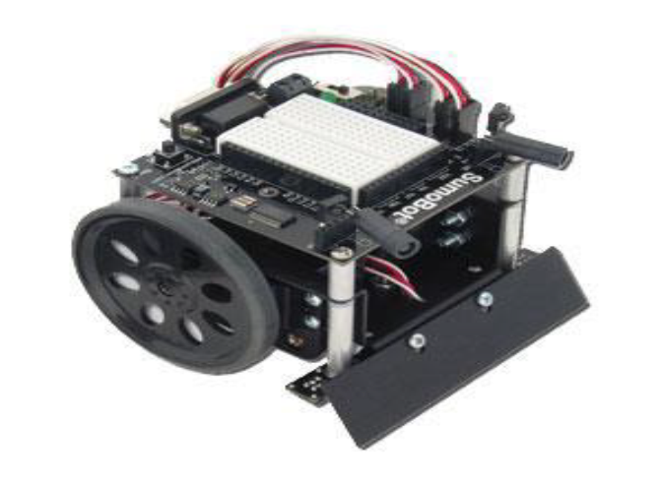
Existing Design #3: Parallax SumoBot
Parallax SumoBot is manufactured by Trossen Robotics and has specifications which are useful to our design. The SumoBot is controlled by use of a remote control, a 4AA power pack and servo motors. The 4AA power pack ensures that the device is supplied with the right amount of power to facilitate effective operation. In addition, it has 2 module and infrared sensors to detect your opponent and the edge of the Sumo Ring. As a result, it enables the player to detect when opponent is ready to strike and hence prepare in advance how to make an appropriate move or counter attack. The device has high levels of safety since it has sensor inputs .The major cons are that the device is made up of numerous components hence making its assembly to be too complicated. This also makes the device to have a lot of linkages hence making its assembly to be difficult. The device is not hardy and hence it cannot last for a long period of time.

Slide 10
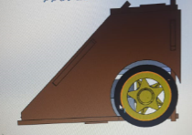
Mechanical design
the robot’s body is made of wooden material – “Plywood” or “Ablakash wood” of thickness 5mm; which is light in weight, high strength
the dimensions of the robot as shown in the figure have been decreased from 20x20cm to 20x10cm; its width (from its sides) are 10cm instead of 20cm to make it more compact, so that it can move faster, easier to drift by moving left or right and at the same time to meet the competition’s rules.

Slide 11
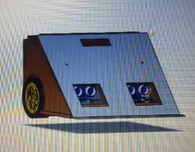
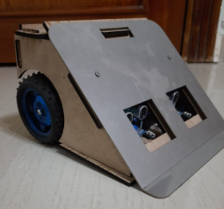
The front part of the robot, as shown in the figures– ‘slider’ is made of a harder material which is stainless-steel as it is stronger, more durable & can withstand the collisions from the opponent.
Also, the slider is inclined at an angle equivalent to 45 degrees that can carry the opposite robot easily out of the ring once they collide during the attack.

Slide 12
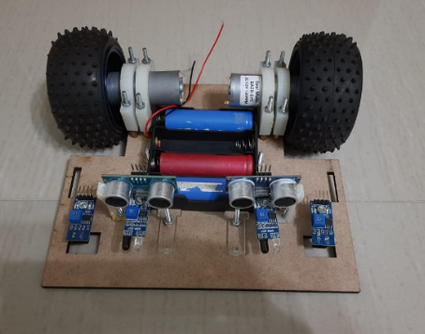
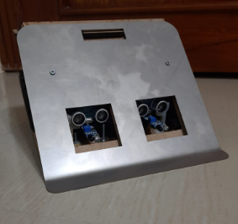
At the bottom of the robot, as shown in figure there are few holes made for the TCRT-5000 IR sensors which are at the front to detect the field in front of it while in motion. As well as there are holes made in the front top of the robot, as shown in the figure for the ultrasonic sensors and the IR sensors which are used to detect the opposite robot.

Slide 13
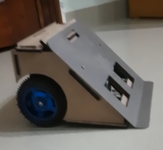
Besides, the sumobot is designed to have two wheels at the back of the robot rather than four wheels that is easier to be in control, letting the front part of the robot to be in friction with the ground. Therefore, the robot is harder to be pushed by the opponent, as well as its slider at a lower level than the opponents’ that will increase the robot’s priority to lift the opposite robot off the ground. As shown in the figure

Slide 14
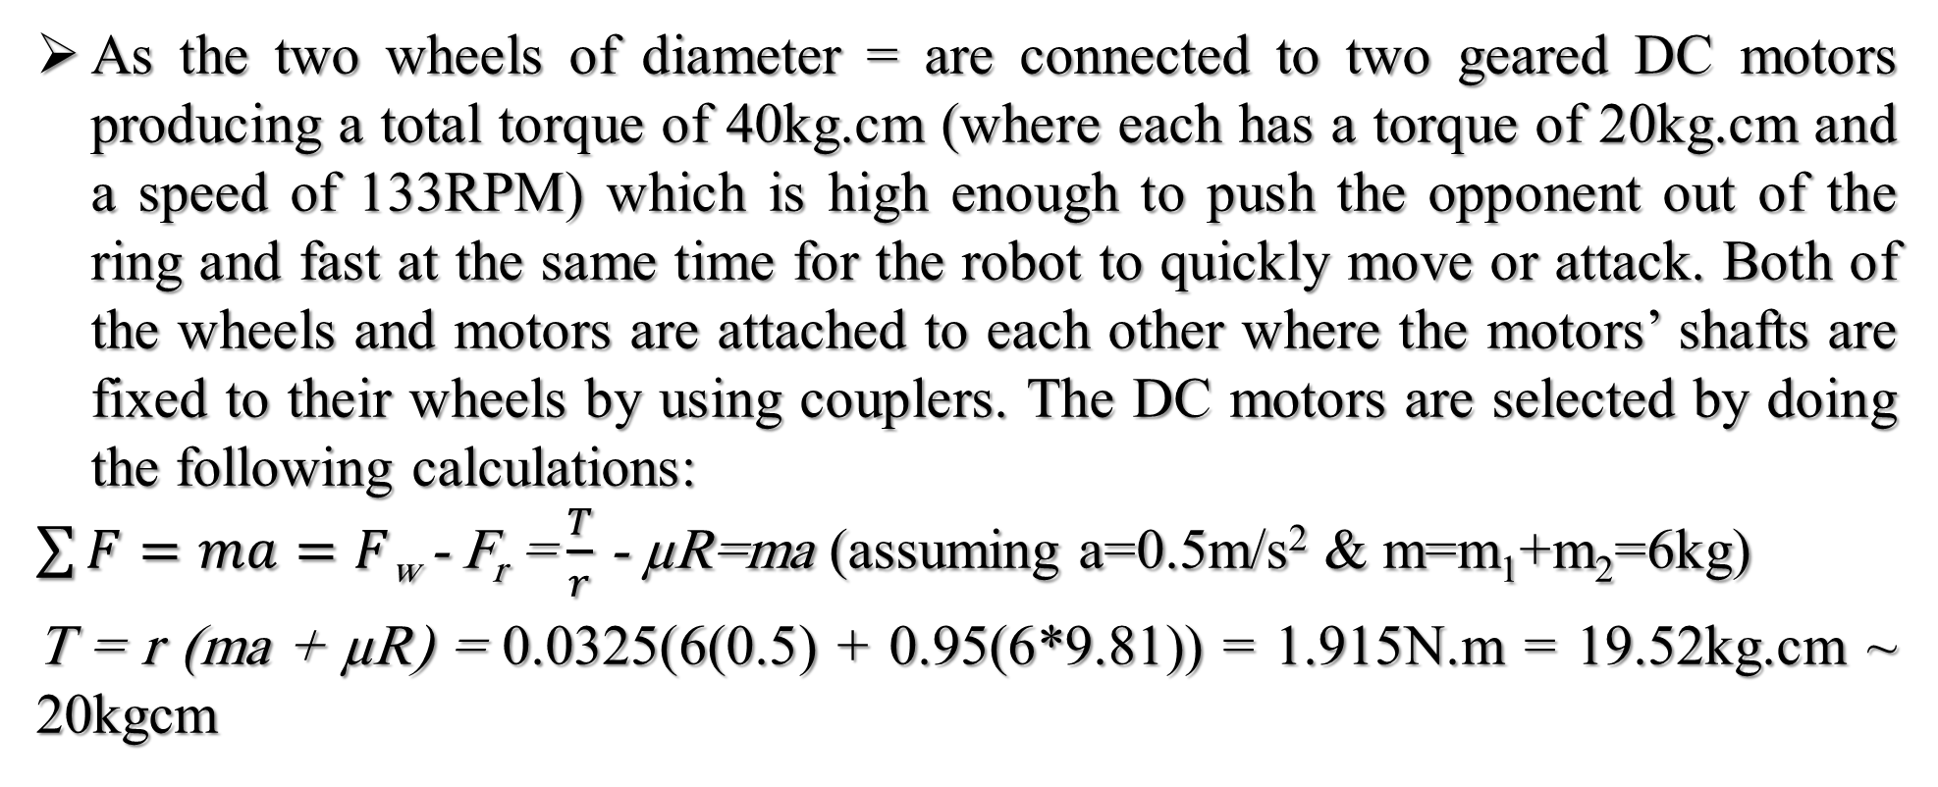
As the two wheels of diameter = are connected to two geared DC motors producing a total torque of 40kg.cm (where each has a torque of 20kg.cm and a speed of 133RPM) which is high enough to push the opponent out of the ring and fast at the same time for the robot to quickly move or attack. Both of the wheels and motors are attached to each other where the motors’ shafts are fixed to their wheels by using couplers. The DC motors are selected by doing the following calculations:
$\sum{F=ma=F}$_{w} - F_{r} = $\frac{T}{r}$ - µR=ma (assuming a=0.5m/s² & m=m₁+m₂=6kg)
T = r (ma + µR) = 0.0325(6(0.5) + 0.95(6*9.81)) = 1.915N.m = 19.52kg.cm ~ 20kgcm

Slide 15
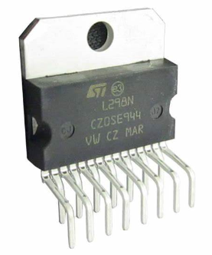
In the final project, a single L298N motor driver IC, as shown in the figure is used which is capable of controlling two geared DC motors with operating voltages up to 46 volts and maximum output current up to 4 amperes; as shown in the datasheet found at the reference section. In addition to that, there are loads of mass = 1kg that are placed exactly at the centre of the robot’s bottom area, in order to increase its stability with the ground. By having its centre of gravity at the centre of the robot’s body to concentrate its weight at the middle, so that it is lowered to the ground and at a wide base area at the same time which makes it harder to be flipped.

Slide 16
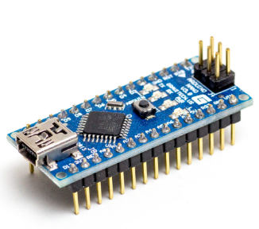
Electrical design
, the microcontroller selected is Arduino nano which is small in shape and dimensions. It uses a specific version of C++ programming language; it has many advantages like :
performing multiple tasks efficiently
having many input/output ports to connect multiple actuators or sensors like as shown in figure

Slide 17
Besides, the orientation of the sensors has been changed as after many tests it was seen that the rear TCRT-5000 IR sensors at the bottom of the robot are useless, since the robot’s strategy is to attack by moving forwards so it will only use the front TCRT-5000 IR sensors (two sensors; one at each side) to detect the field. Added to that, the usage of two ultrasonic sensors at the front top part of the sumobot instead of one ultrasonic at the middle, in order to detect the distance between our robot and other robots that might be dim in colour (dark black) or transparent that the IR sensors fail to detect.
These ultrasonic sensors are placed at a distance of 10cm away from each other, in order to detect the robot attacking from the left or from the right as it covers a wide range of area and avoid the interference of the signals coming from each sensor.
Along with the ultrasonic sensors, there are two IR sensors used; where each IR sensor is adjacent to an ultrasonic sensor. These IR sensors are used, so that it can accurately detect any robot in front of it due to its focused beams (not easily susceptible to noise) and faster response.

Slide 18
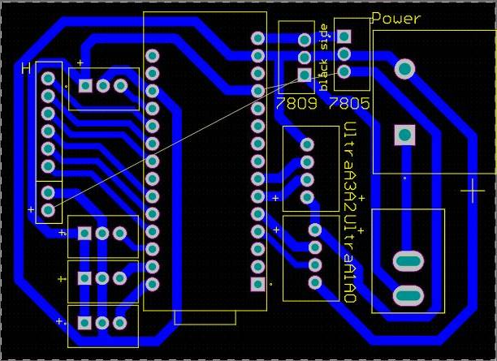
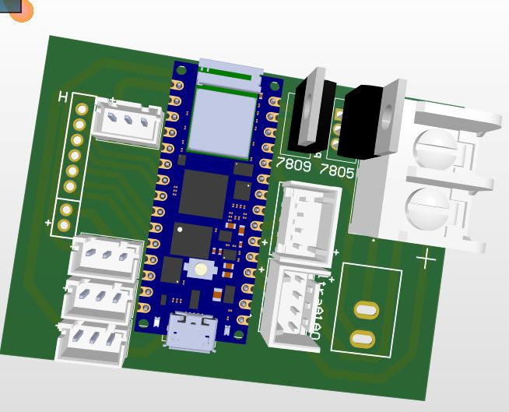
a greater voltage supply equivalent to 16v is used (4 lithium-ion batteries of 4v) so another rosetta connector is used which is larger in size to withstand high current.
In addition to, the usage of regulators like 7805 (5v regulator) to supply 5v to the sensors (ultrasonic sensors and IR sensors)and 7809 (9v regulator) to supply 9v to the microcontroller
As another PCB was designed as shown in the figures to include all of these modifications to be established in the final sumobot.

Slide 19
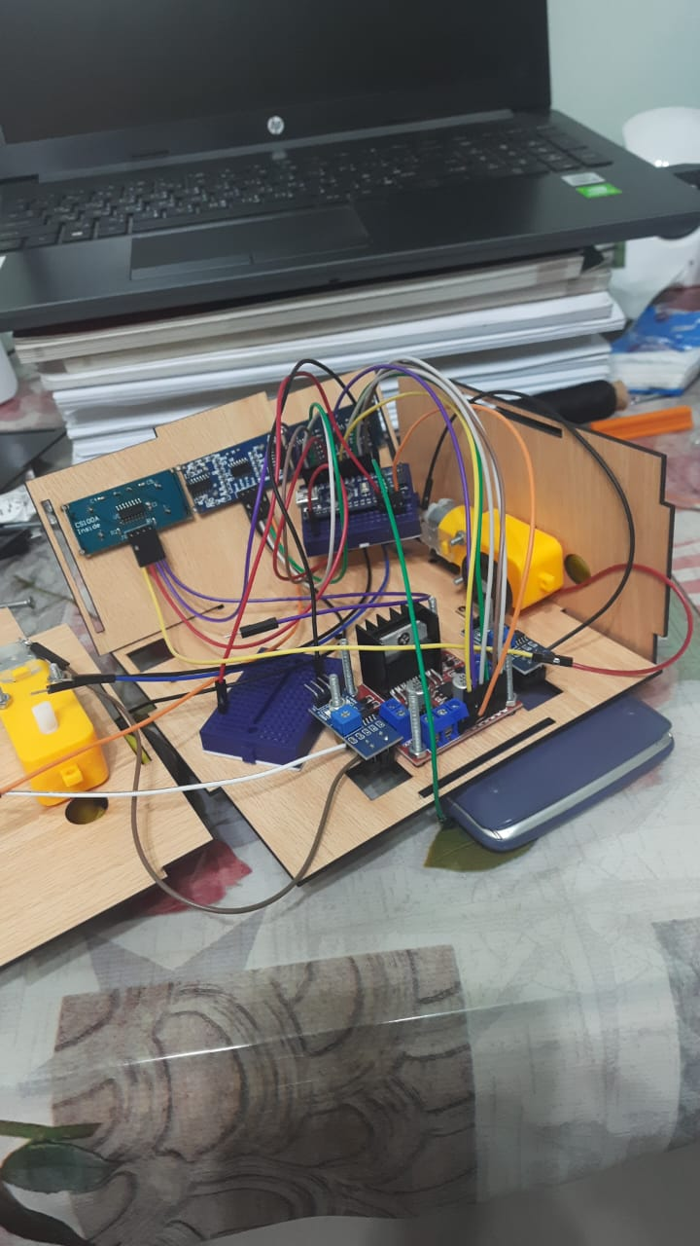
Build a Prototype
To start with, the first solution presented to the problem faced while doing the electrical design as shown in the next figure, where it was planned that a breadboard and wire jumpers will be used for the sumobot.
However, we found that it is an inefficient and unreliable method for the robot’s operation; where the robot is vulnerable to mechanical vibrations when it is in motion, so errors might be experienced.
Also, there are multiple connections used in a very small area, which makes it more difficult for us to trace the electrical connections are made correctly or not while testing the prototype.
As we agreed that the solution to this problem is designing a compact sized PCB, in order to ensure that the circuit is stable, so that the robot can continuously operate without experiencing any loose connections or electronic noise

Slide 20
Besides, the solution presented to the second problem of the sensors used at the front top of the robot which were 3 ultrasonic sensors for detecting the opponent (like as shown in the previous figure)
which we found that there will be highly inaccurate results where the robot cannot detect objects in front of it.
The solution presented is using a single ultrasonic sensor to have reliable results by measuring the distance accurately and two IR sensors to easily detect any smaller robots accurately since it is faster in response and has much more focused beams that is not easily interfered with.

Slide 21
Added to that, the solution presented to the fourth problem that is related to the robot’s strategy
where the first code that was typed had a problem in saving the previous direction for the robot to follow
so there were modifications be made in the code.

Slide 22
Moreover, the solution presented to the fifth problem is considering the motors used were weak in producing the required torque for the sumobot to accelerate and successfully carry other robots out of the ring while attacking.
That is why we decided that one of the tasks to be done is calculations based on cases that the sumobot will experience to get the best DC motors.

Slide 23
As we successfully accomplished all of the tasks considering the solutions to the problems faced while designing the prototype; such as:
Task 1: Selecting the most suitable sensors.
Task 2: Designing a compact PCB & fabricating.
Task 3: Testing many different strategies by typing different codes.
Task 4: Doing calculations to select the best DC motors required.
Task 5: Searching for DC motors required in stores.

Slide 24
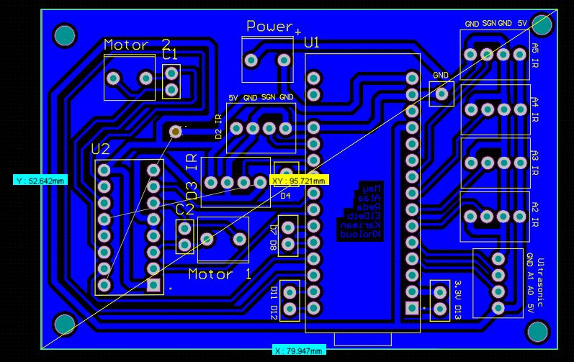
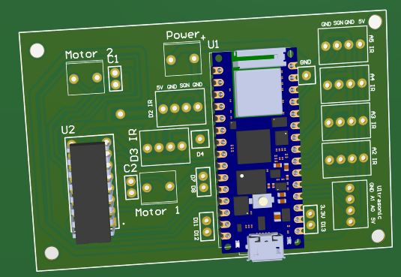
Pictures of the prototype’s design

Slide 25
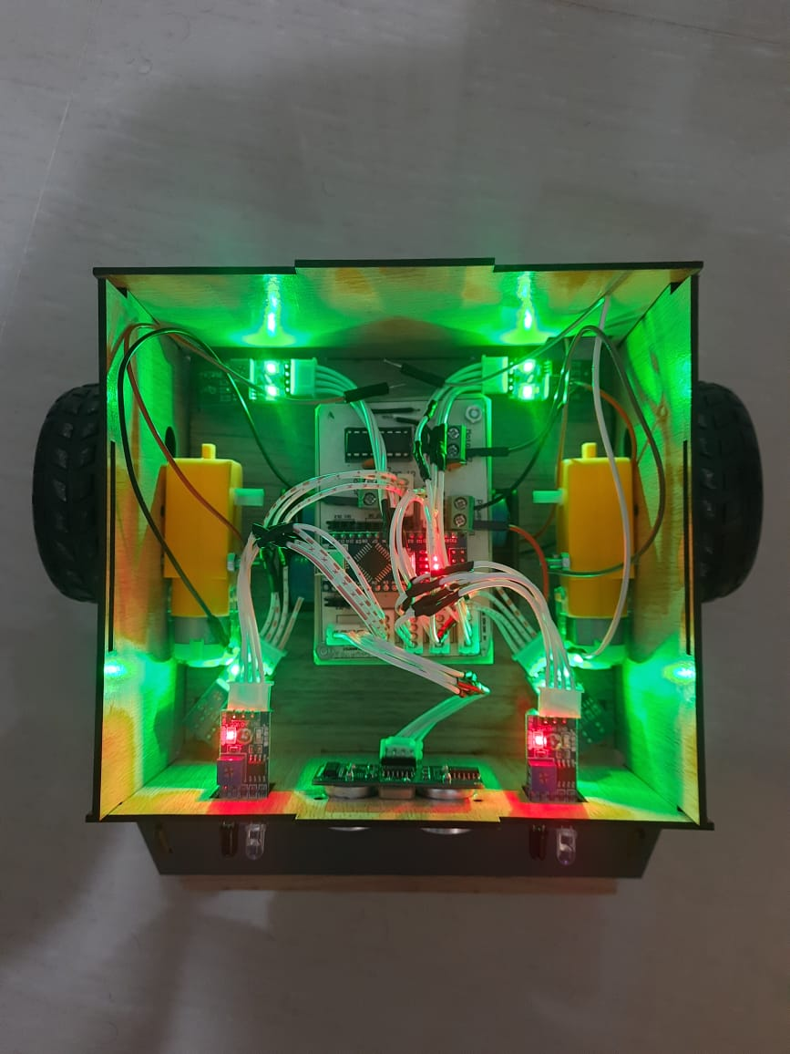
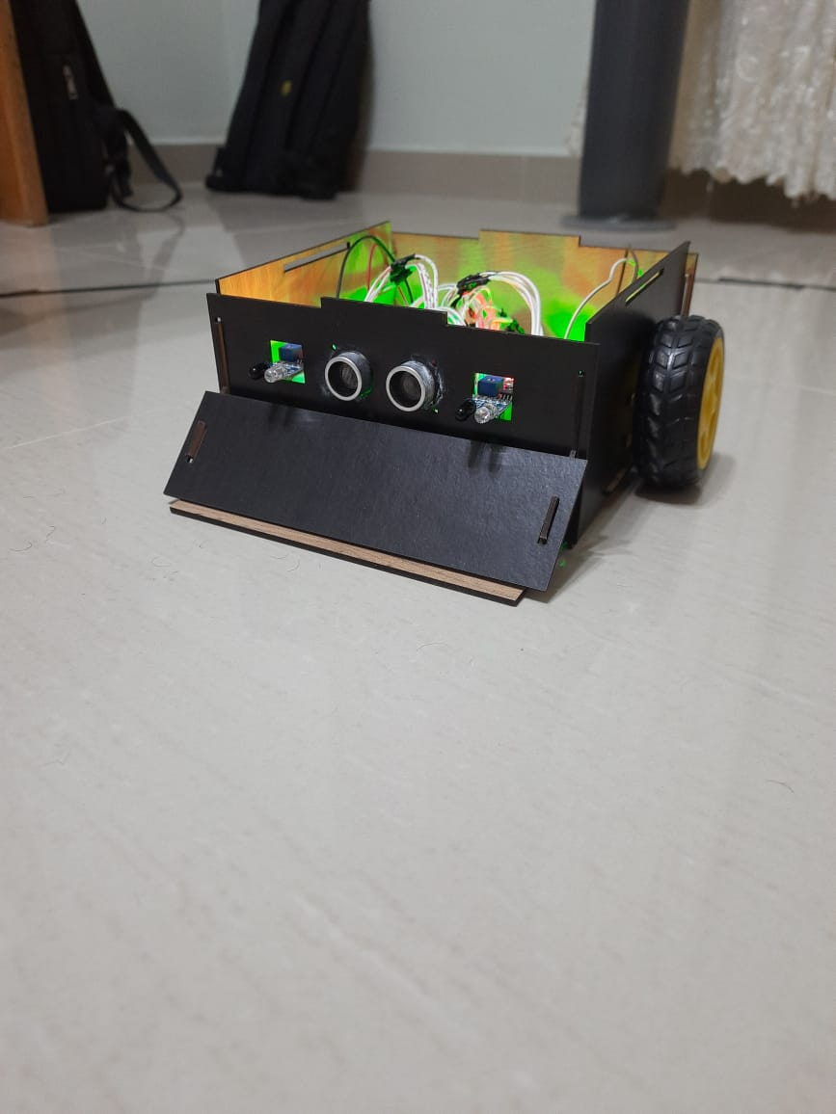
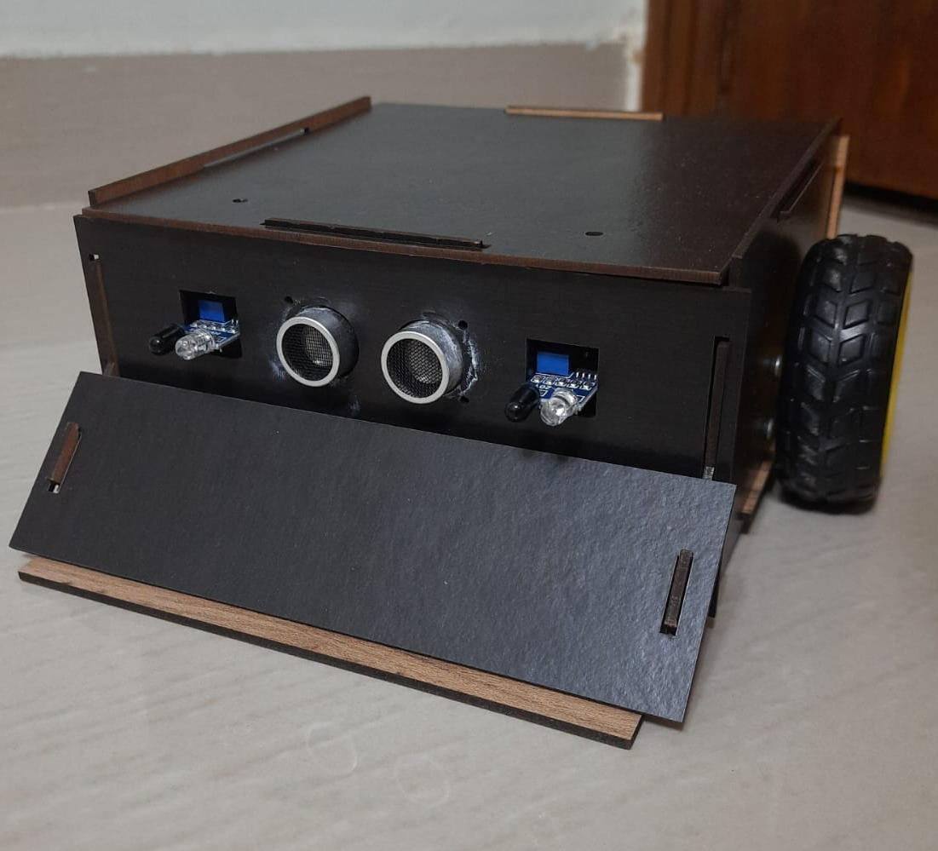

Slide 26
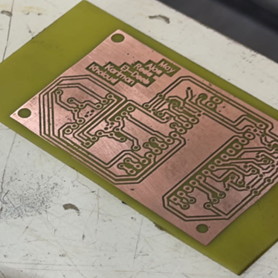

Slide 27
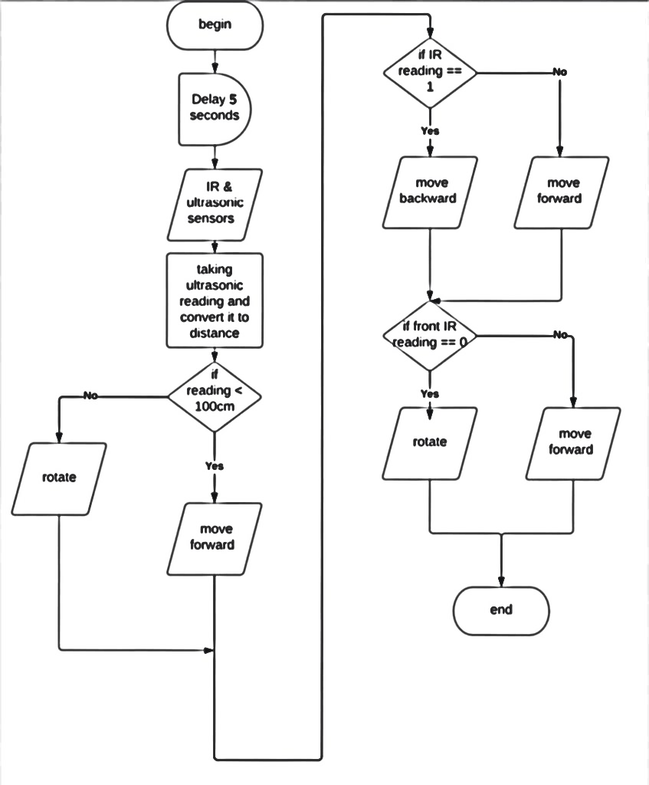
Control Code
Flowchart

Slide 28
Conclusion
I am pleased to say that we have successfully designed a powerful sumobot which is fast in motion and attacking, as well as not easily detected by its dim colour.
Everything went according to our plan, however some of the tasks have consumed longer durations than the estimated. Gladly, I would like to say that the robot is ready and qualified to compete in this competition as it follows all of the competition’s constraints

Slide 29
Cost Analysis
Robot’s body (wood + stainless steel slider): 300 LE
Motor (from Makers): 250 LE
Motor (from Amazon): 350 LE
2 x IR sensors: 2 x 35 = 70 LE
4 x lithium-ion batteries: 4 x 50 = 200 LE
4 cell battery holder: 20 LE
PCB board fibreglass (10x10cm) = 30 LE
L298N motor driver IC: 35 LE
7805 voltage regulator: 4 LE
7809 voltage regulator: 4 LE
Glossy paper: 4 LE
Etching acid solution (Ferric chloride): 30 LE
Pin female headers 40 pin (for Arduino nano): 6 LE
7 x Flat cable connector 4 Pin Male: 7 x 2.5 = 19.5 LE
3 x Terminal 2 pin: 3 x 2.5 = 7.5 LE
10 x Data cable JST 4 pins: 10 x 6 = 60 LE
Expenses for using drillers and soldering tools for PCB fabrication: 100 LE
Arduino nano: 200 LE (Borrowed)
2 x TCRT-5000 IR sensors: 2 x 35 = 70 LE (Borrowed)
2 x Wheels: 2 x 200 = 400 LE (Borrowed)
2 x Ultrasonic sensors: 2 x 45 = 90 LE (Borrowed)
Total cost (paid + borrowed) = 2,250 LE

